Slide 1


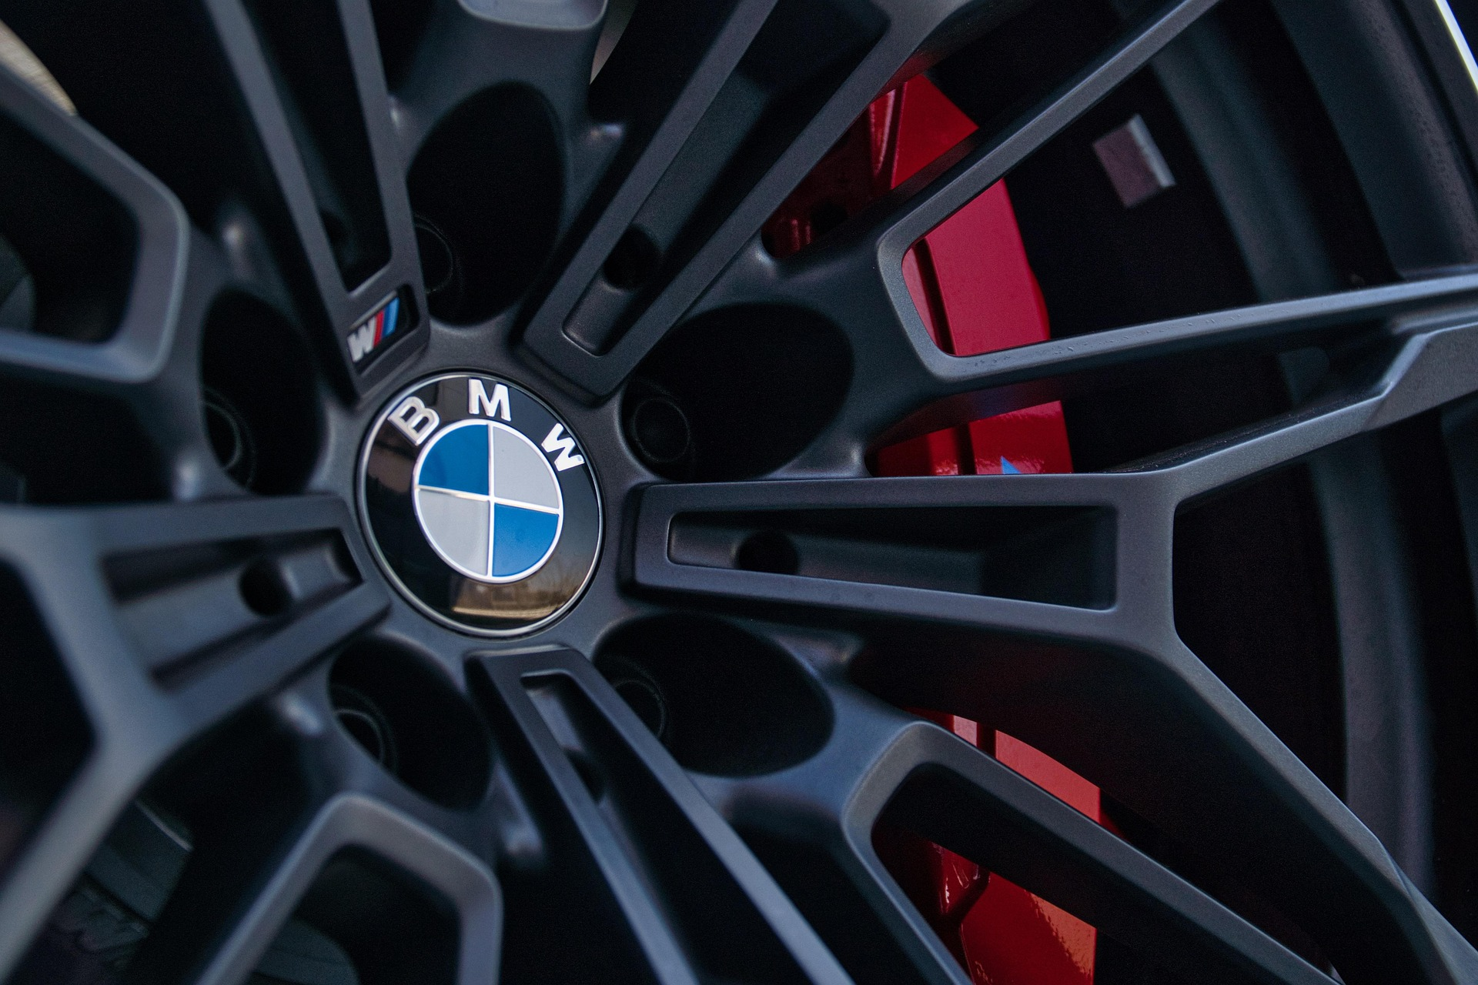
ي
BMW
"The Ultimate Driving Machine"
BMW Report Analysis
By : “Ahmed Hany”
Key Performance Indicators (KPIs)
Total Sales
Total Quantity
$3,751,730,045
253375734
Num Of Models
11
Avg_Mileage_KM
Avg_Engin_Size
100307 km
3.2 L

Slide 2
Sales are split equally between Petrol, Diesel, Hybrid, and Electric. BMW is focusing on all options
Half of customers prefer Manual, and the other half prefer Automatic. BMW covers both needs
High-class cars are a little more popular than low-class ones. Customers like premium options
Sales volumes vary widely between different models. A few top models dominate and drive the majority of unit sales. This shows that customer demand is focused on BMW’s most successful designs.
BMW models are consistently sold across all regions.
Europe and North America show the highest overall demand.
Asia and Middle East also demonstrate strong market presence.

Slide 3
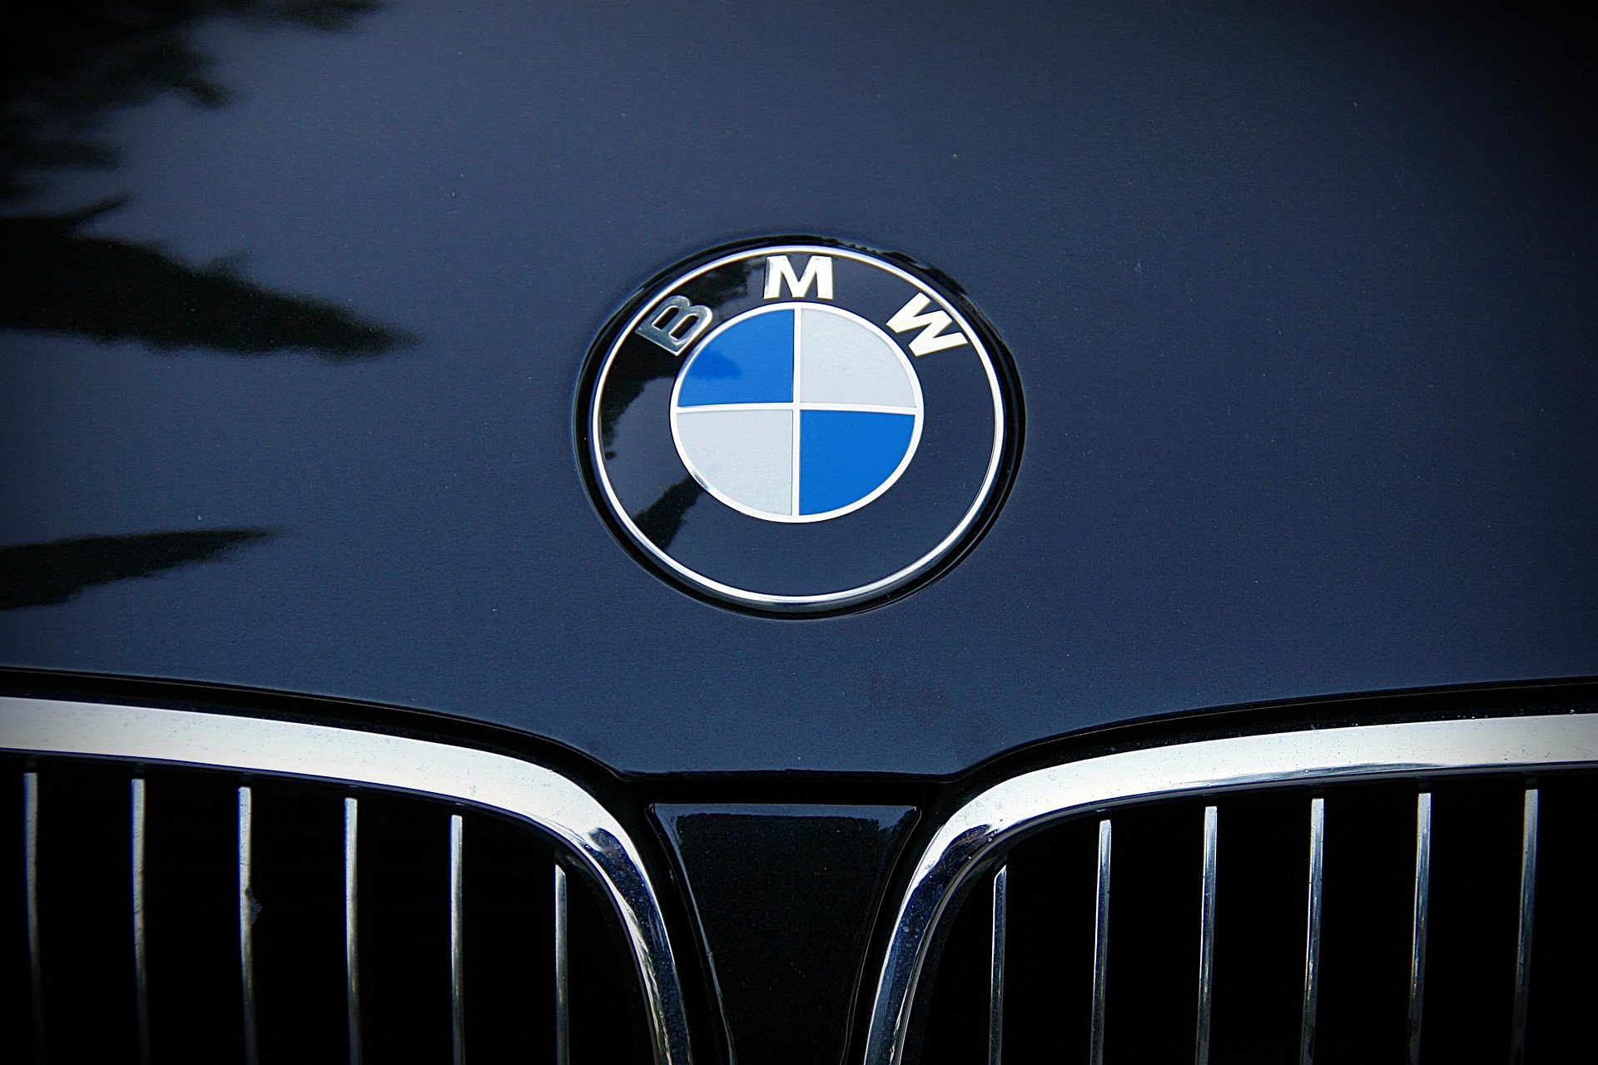
Black is the most popular BMW color, followed by Blue and White. Grey and Silver have smaller shares but remain steady choices. Color trends reflect customer preferences for classic
Some BMW models generate much higher revenue than ,x7 the best
Conclusion
BMW sales analysis from 2010 to 2024 shows clear patterns:
Europe and North America remain the strongest regions.
Petrol cars still lead, but Hybrid and Electric are growing steadily.
Customers prefer classic colors (Black, Blue, White) and automatic transmission.
X7 and premium models bring the highest revenue.
A few top models dominate the global market.
Overall, BMW maintains a strong global position, balancing tradition with innovation to meet changing customer demands.

